Slide 1

Controllable Robot Car Via Blynk

Slide 2
Course Section
Introduction (15 mins)
Self-Introduction
Group Introduction
Introduction to IoT
What’s Blynk? (15 mins)
Introduction about Bynk
Function of Blynk
Mini Project (2.5 hrs)
Introduction (5 mins)
Model Assembly (1 hr)
Software Settings (30mins)
Test Drive (30 mins)
Mini Challenge (30 mins)

Slide 3
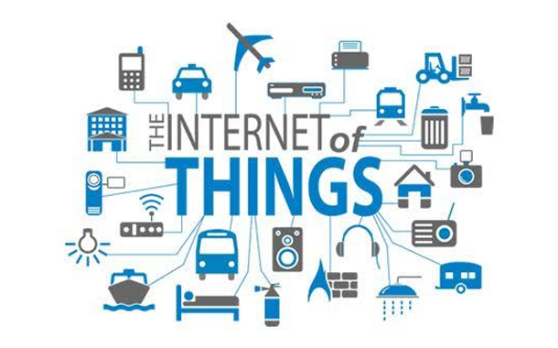

Slide 4
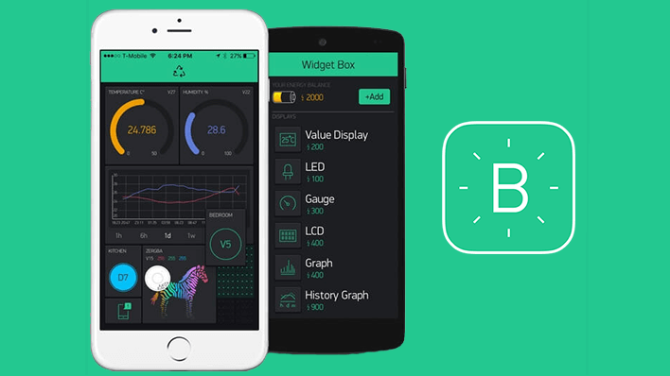
What’s Blynk

Slide 5
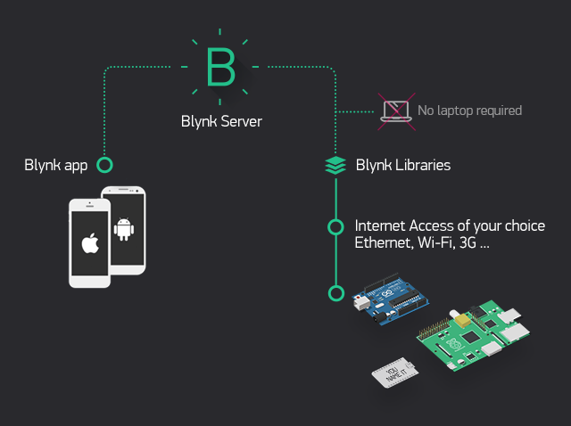
Blynk Server

Slide 6
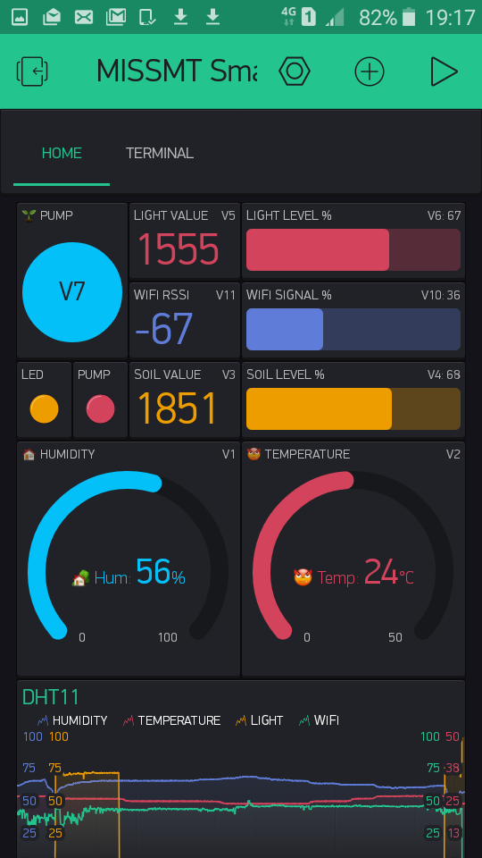
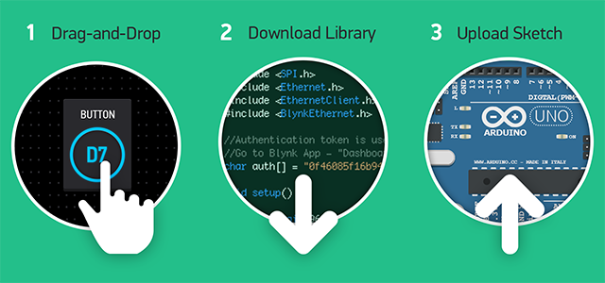

Slide 7
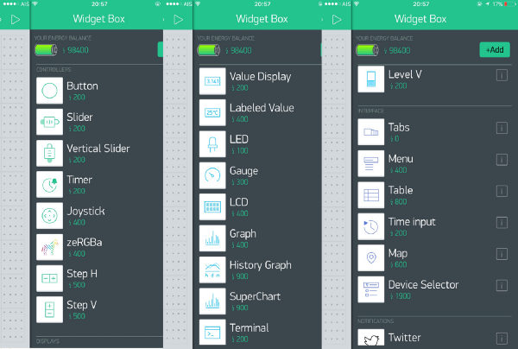
Blynk Energy

Slide 8
Mini Project

Slide 9

KidBright

Slide 10
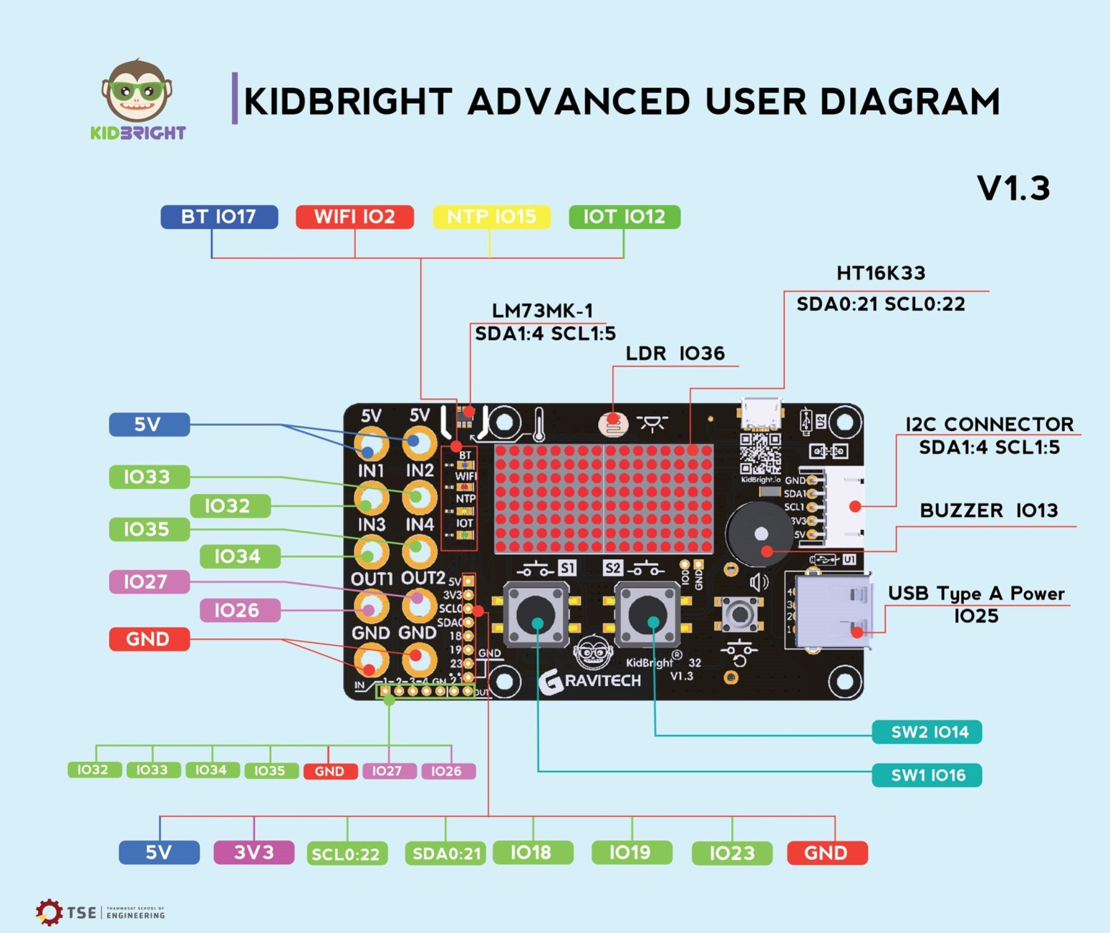
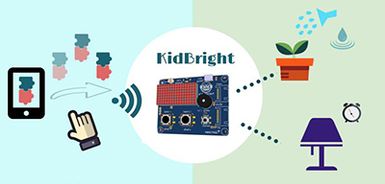
KidBright

Slide 11
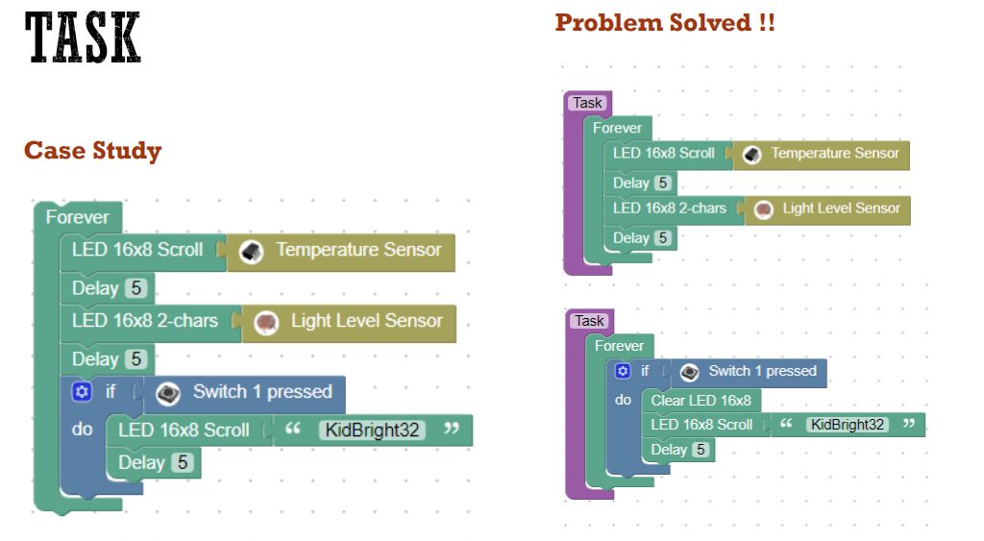
Blockly coding

Slide 12
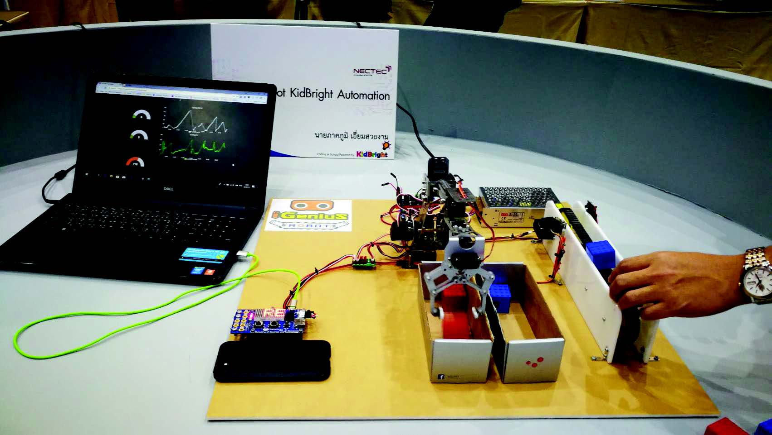
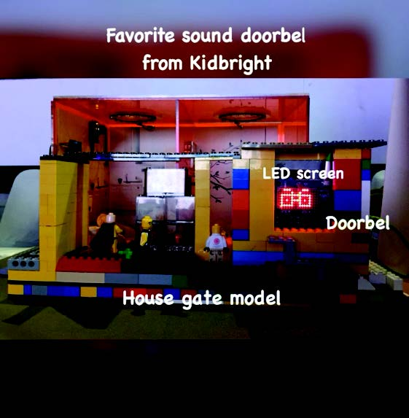
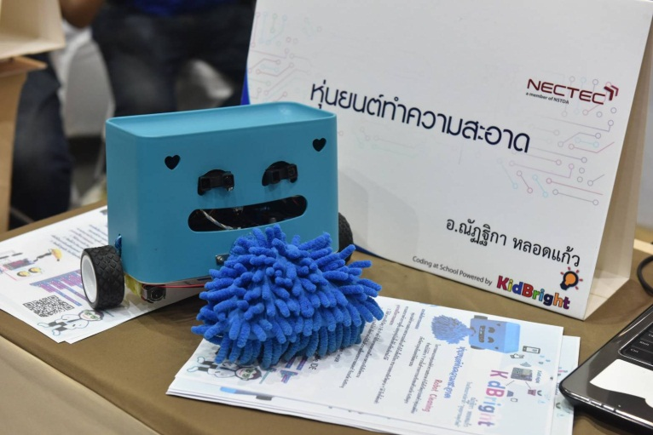
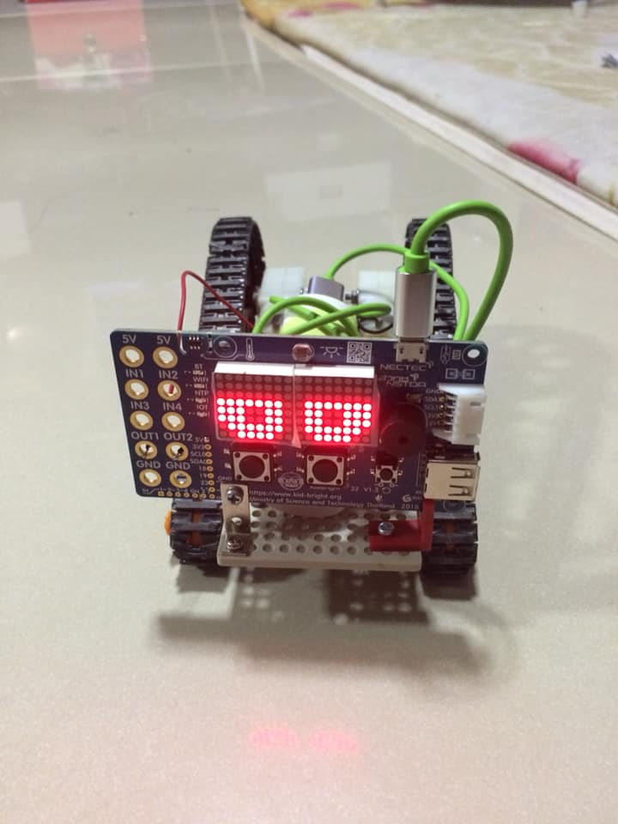
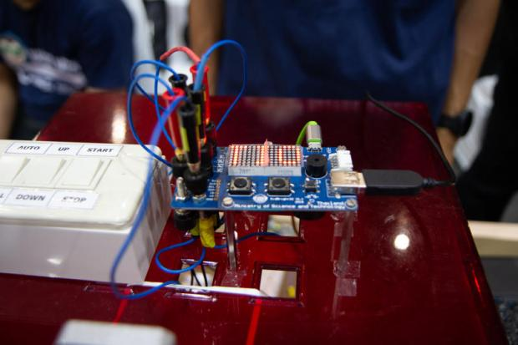
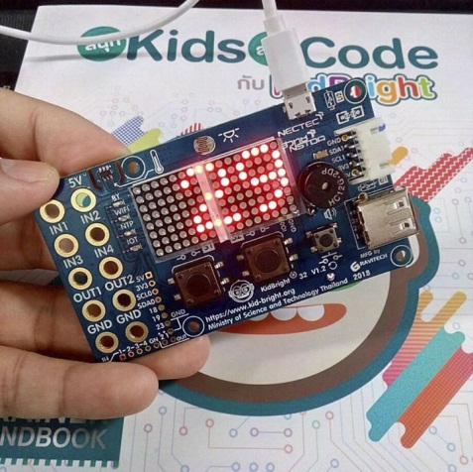
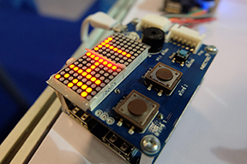
Examples

Slide 13
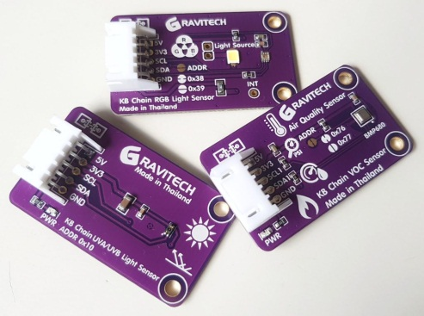
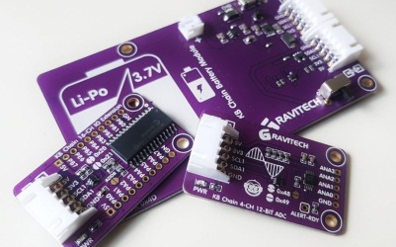
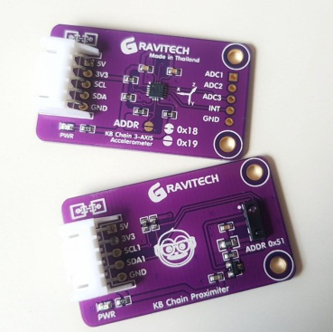
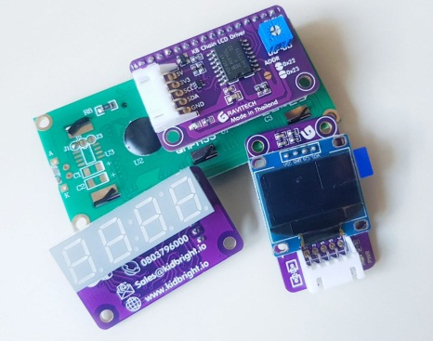
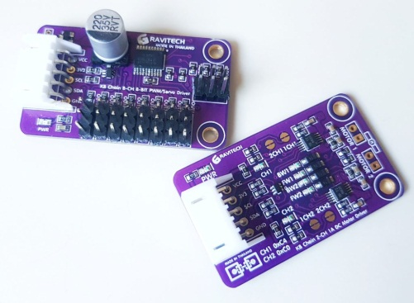
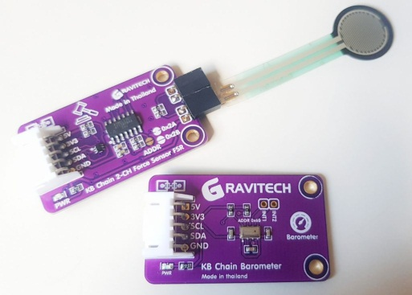
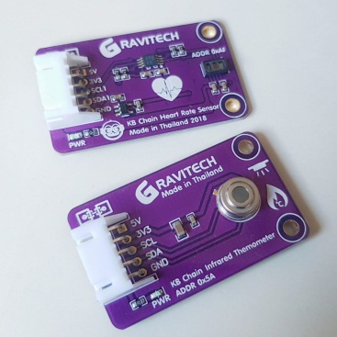
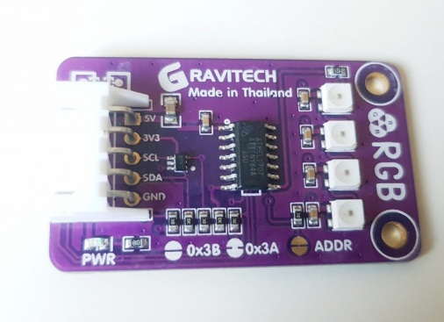
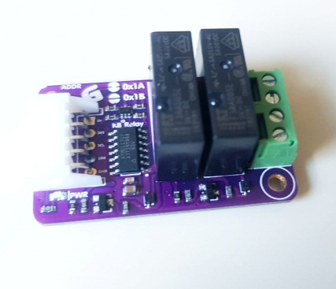
KB Chain

Slide 14
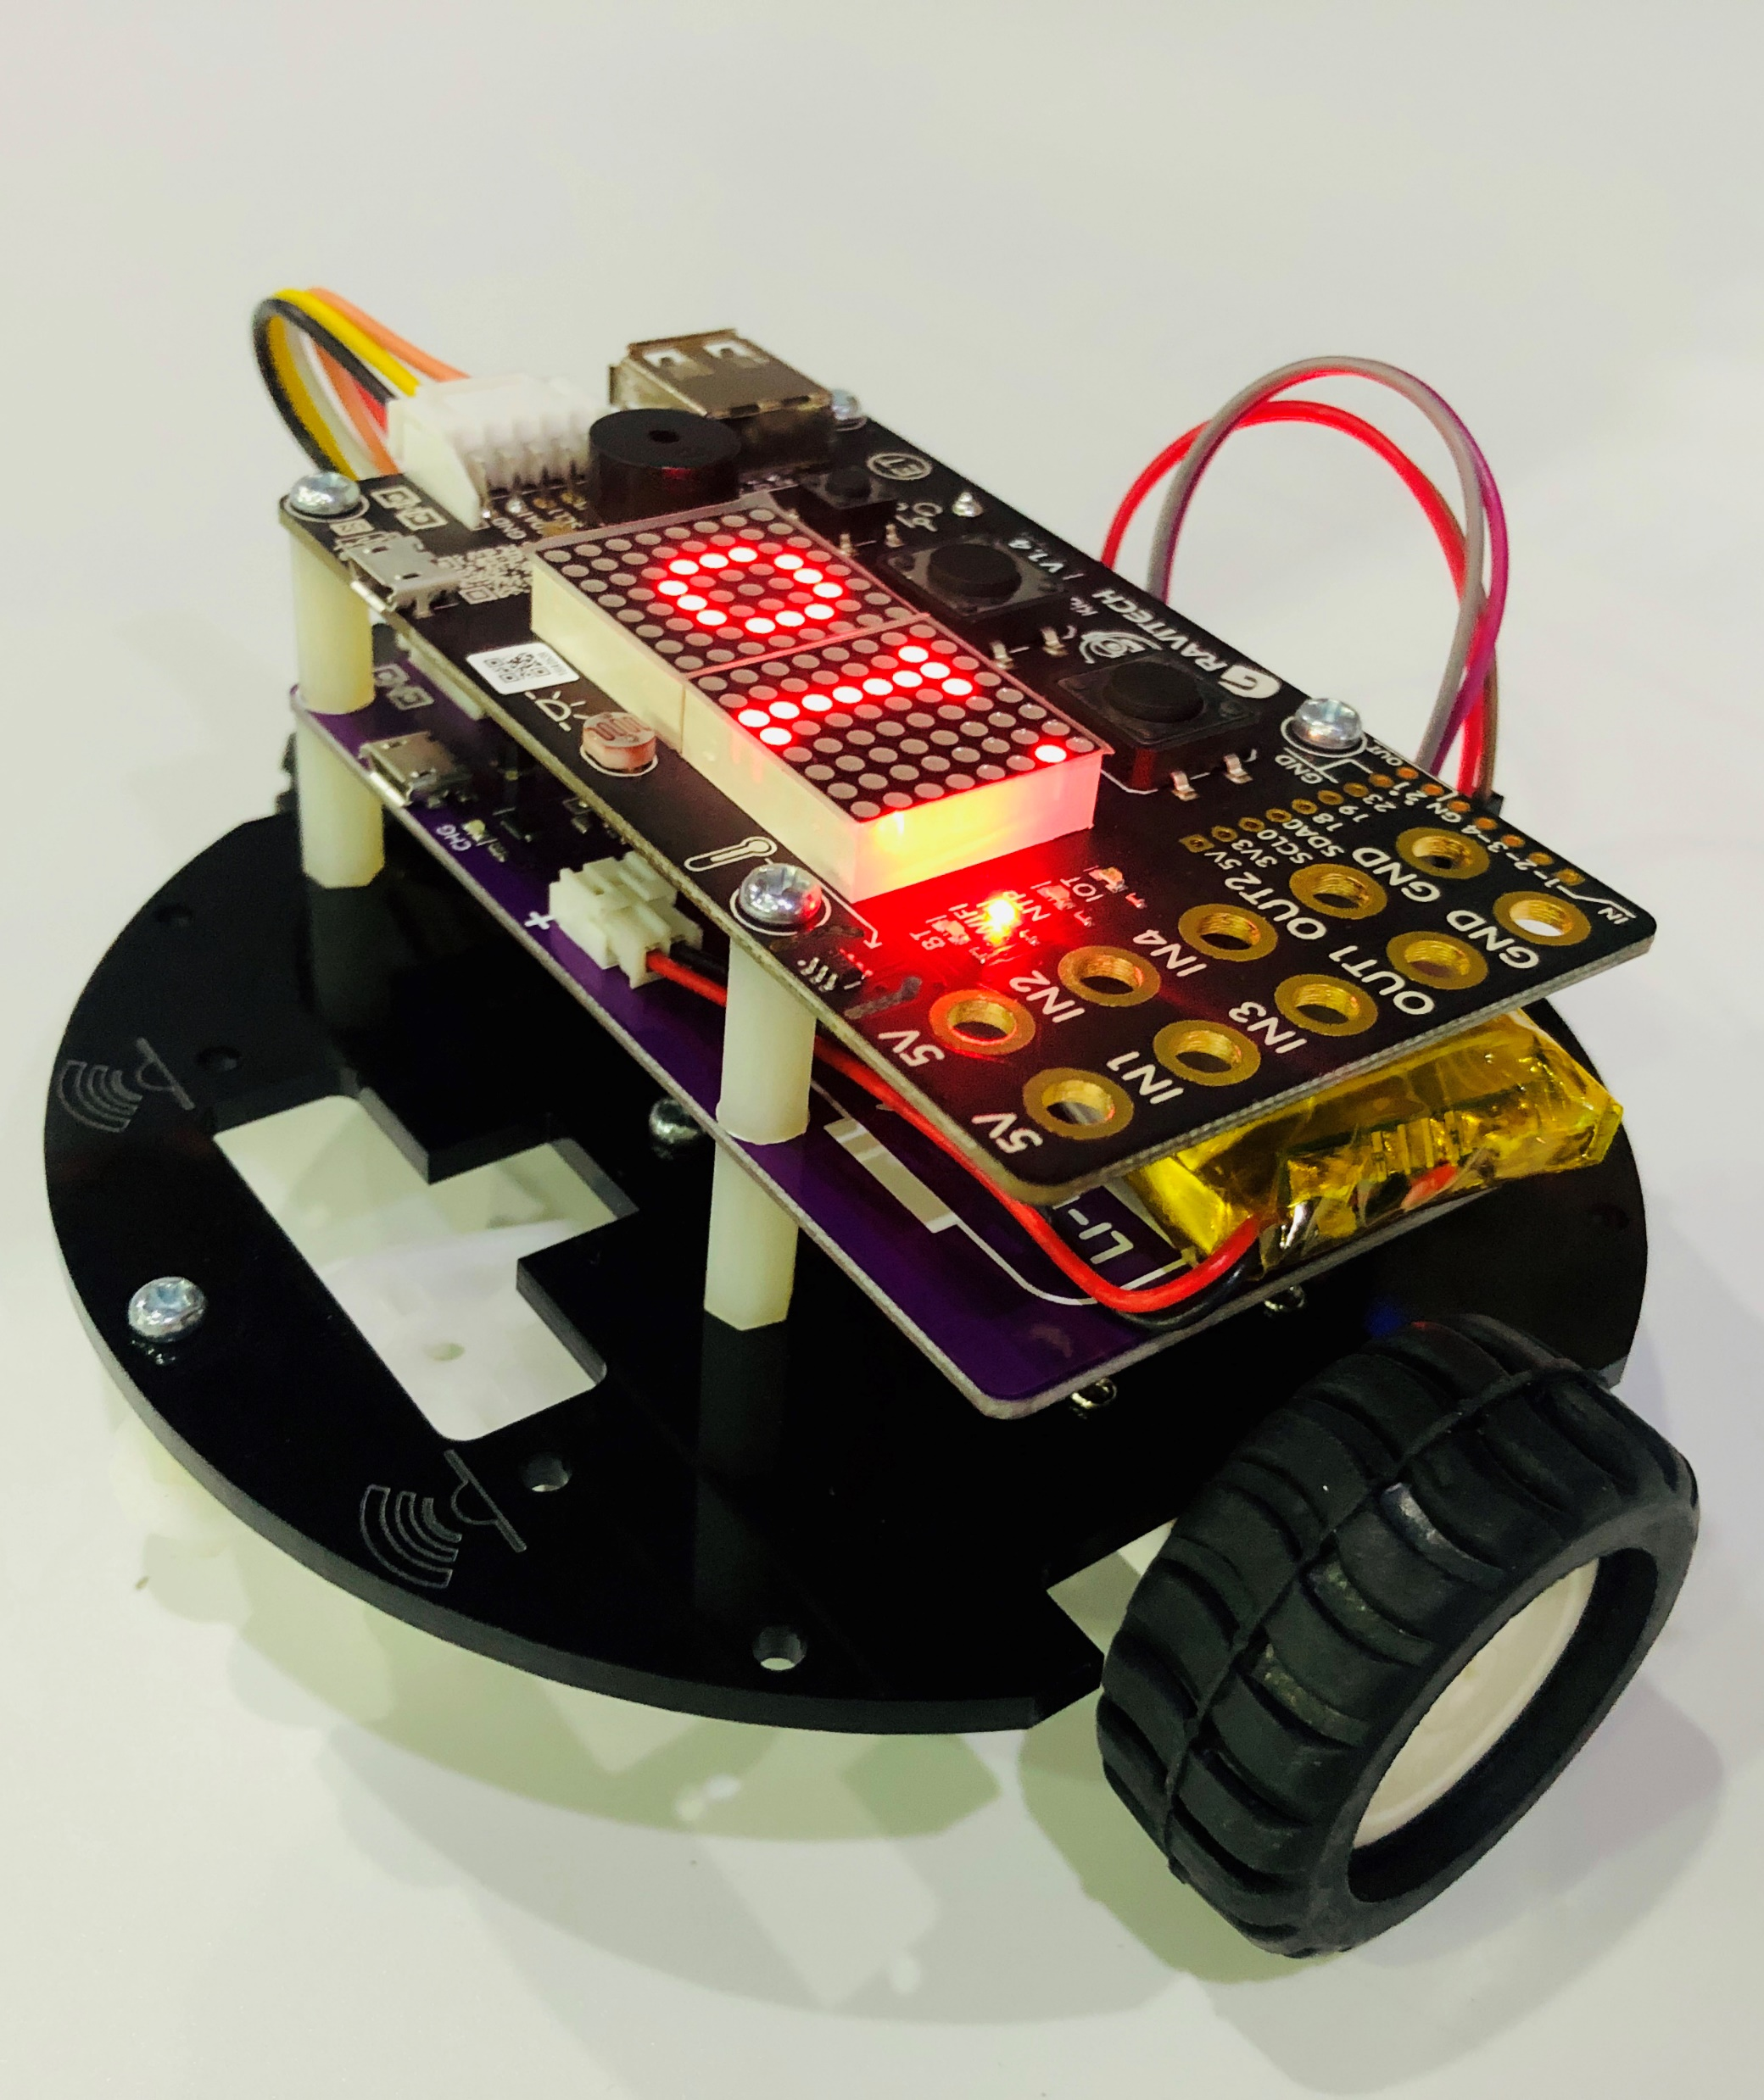
Our project
SIMPLE
USING
CONTROLLABLE
KIDBRIGHT
ROBOT
AND
CAR
BLYNK

Slide 15
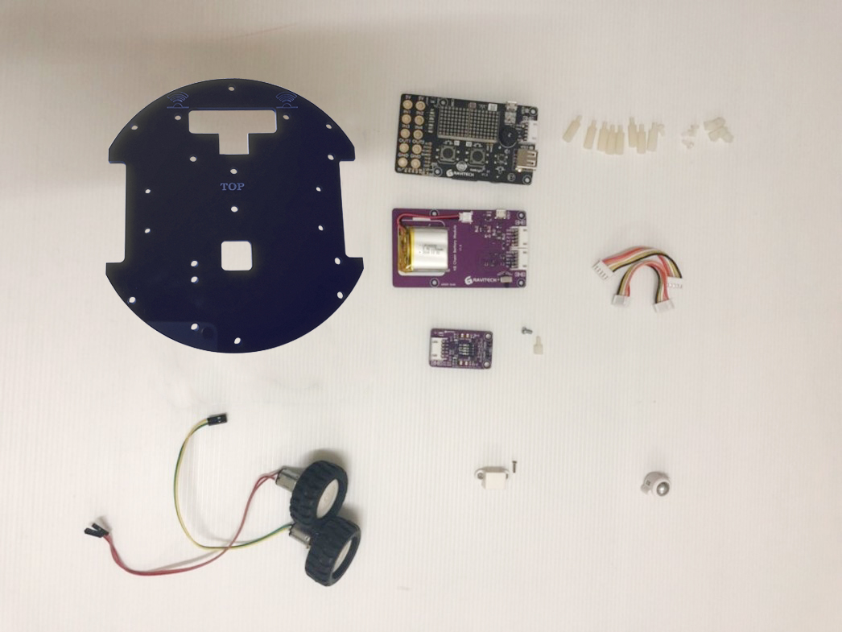
Materials
KidBright Board
Plastic Screws,
Screw caps and Mount Screw
Acrylic Board
KB Chain Battery
Wires
KB Chain
Motor Driver
Steel Ball
Omni Wheel
Wheels and Motors
Bracket

Slide 16
Process 1: Wheels

Slide 17
Process 2: Motor Driver

Slide 18
Process 3: Battery

Slide 19
Process 4: Blynk Board

Slide 20
Process 5: Connect the motor driver

Slide 21
Process 6: Connect the CABLES

Slide 22

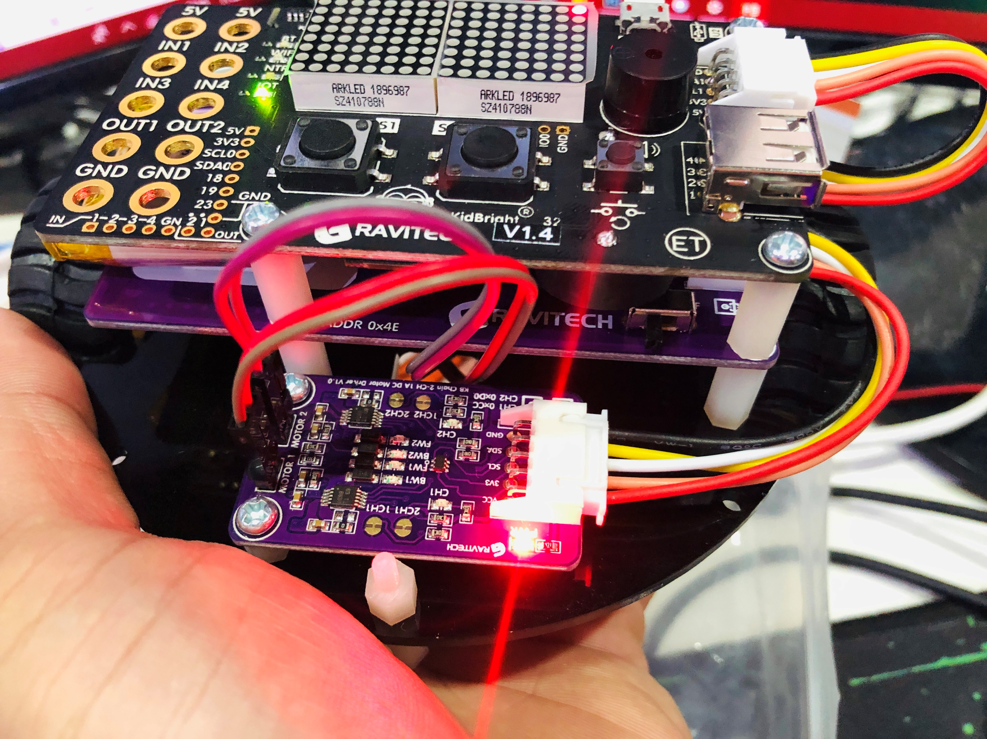
Process 7: Switch on!

Slide 23
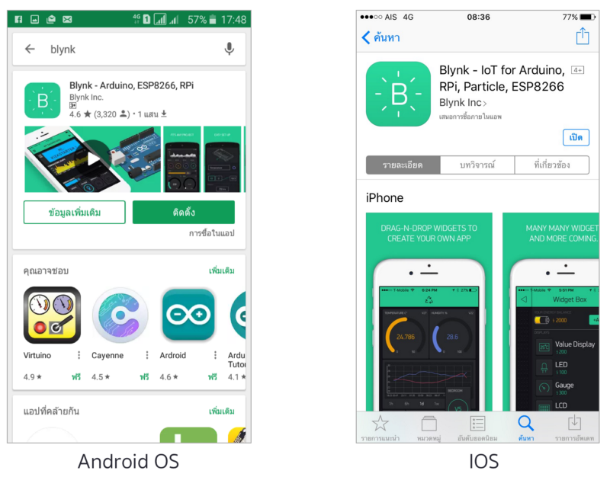
Process 8: Software Setting

Slide 24
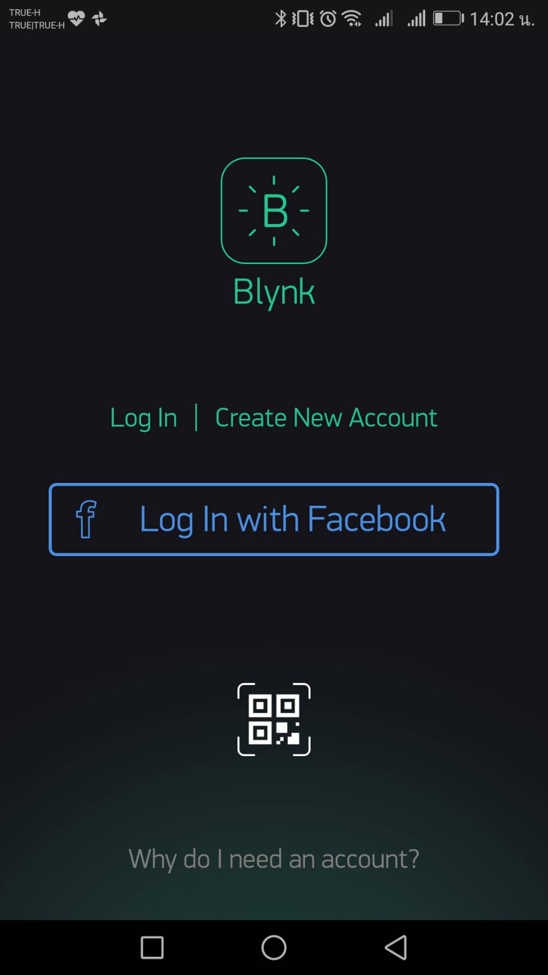

Slide 25
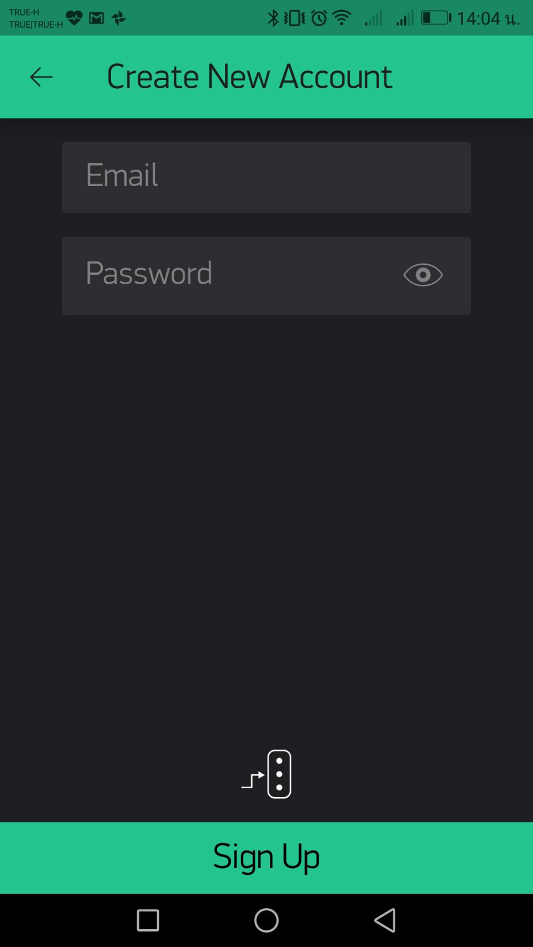

Slide 26
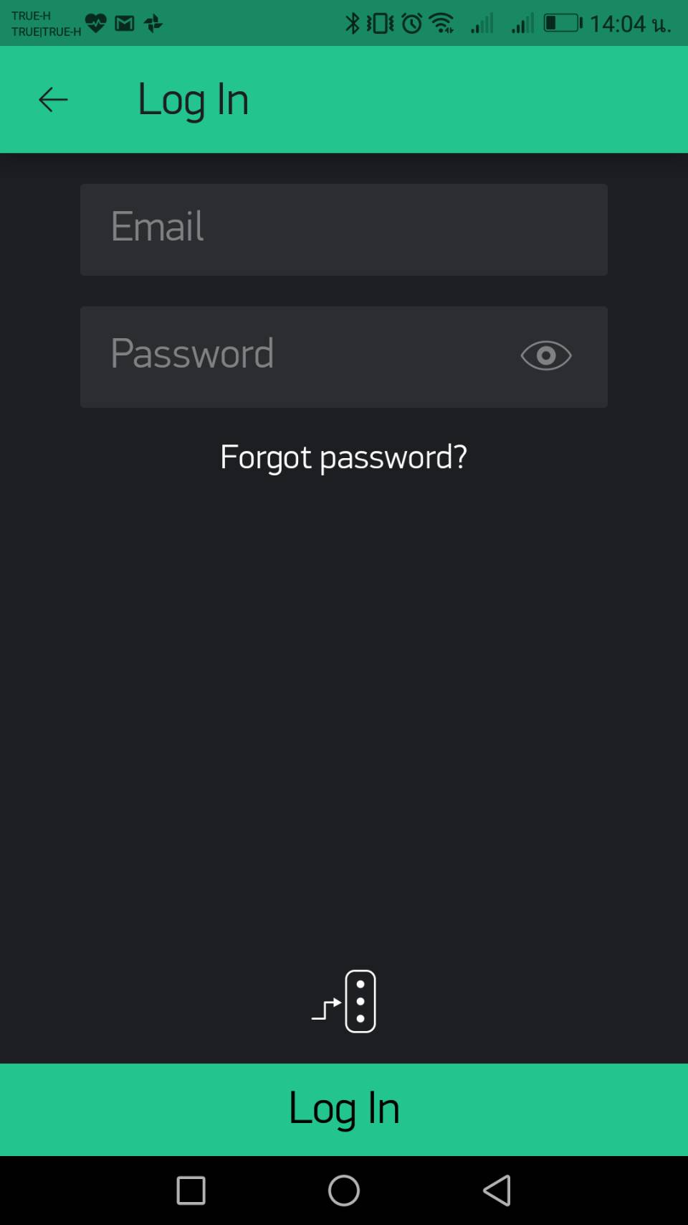

Slide 27
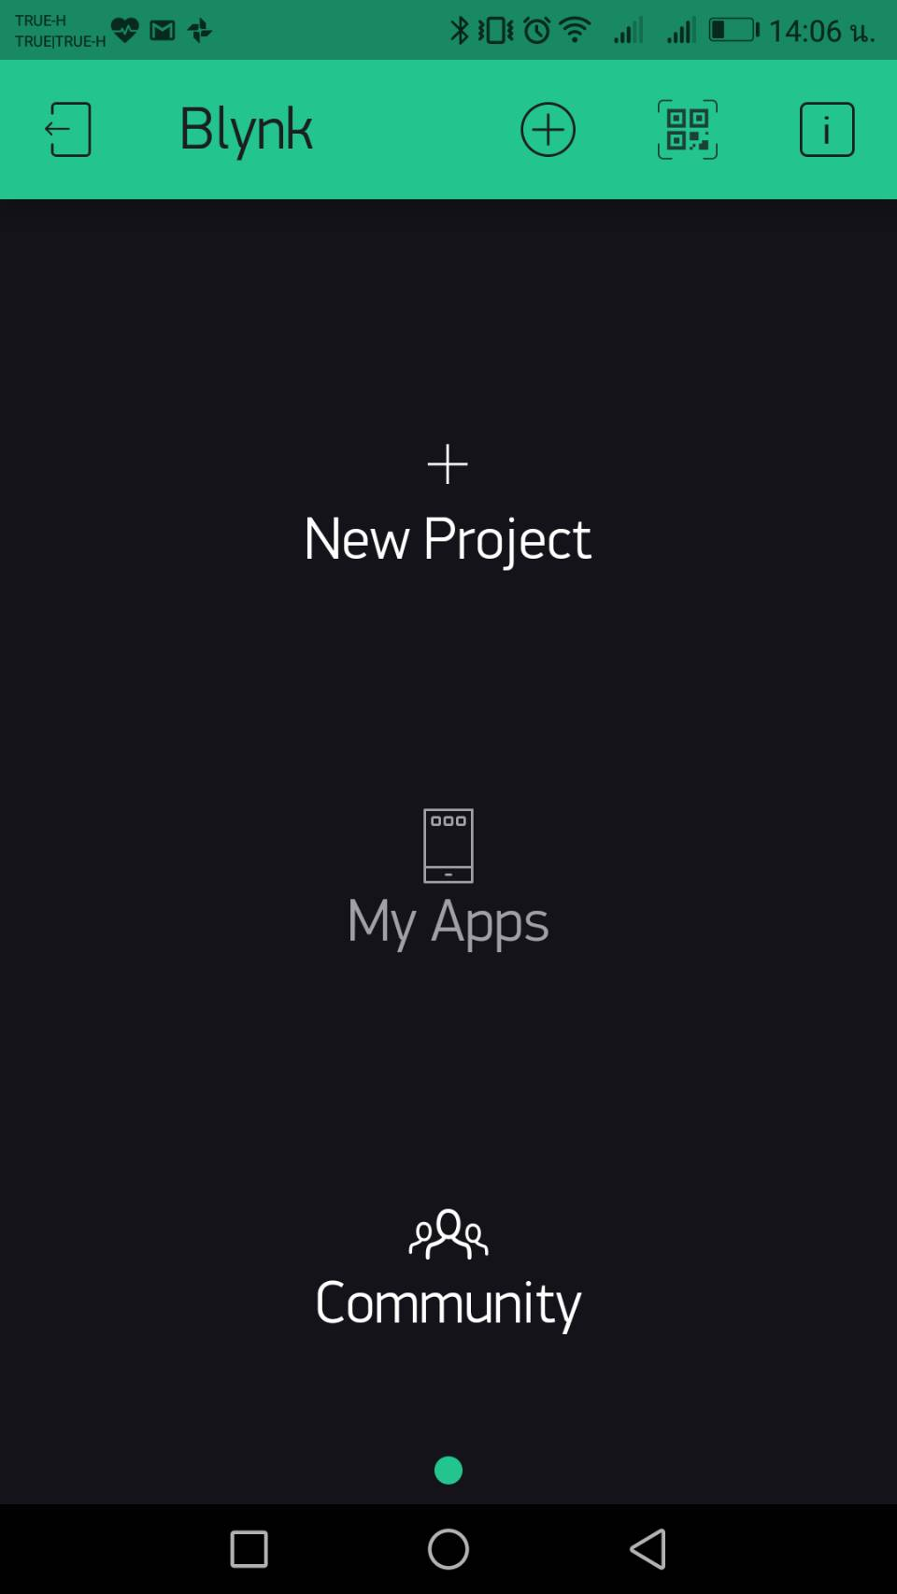

Slide 28
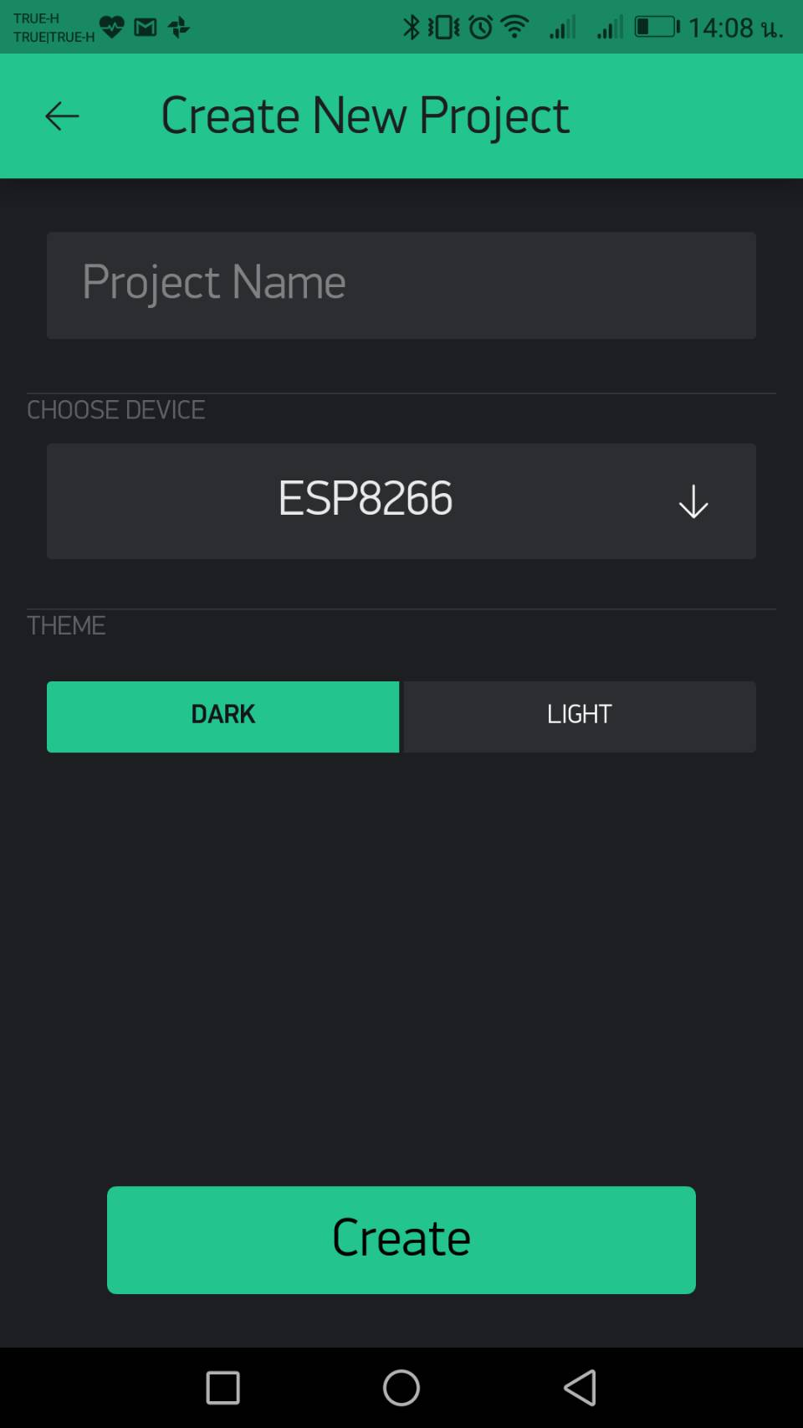
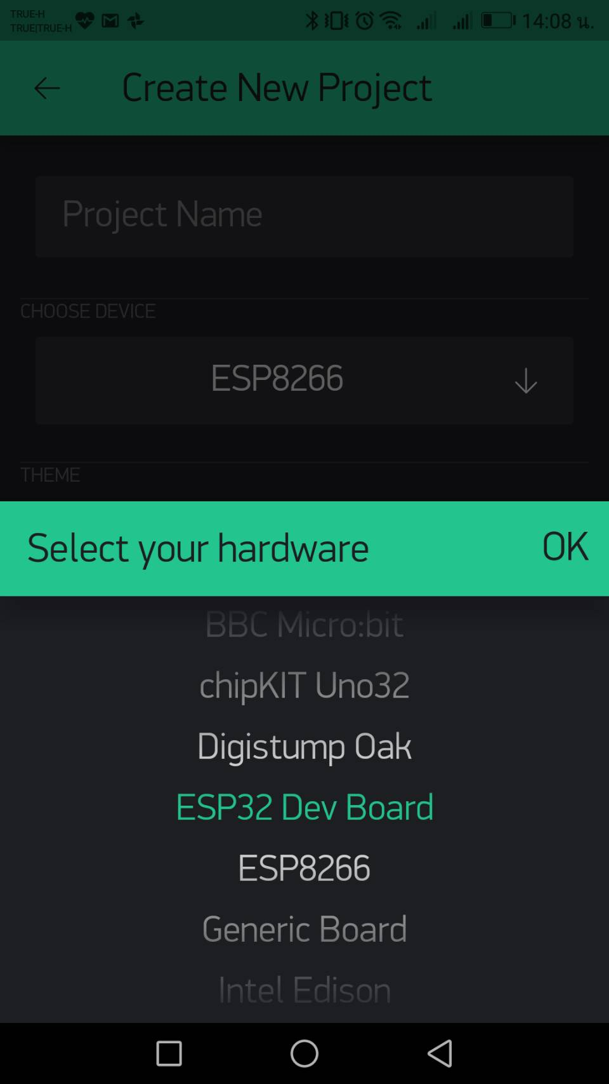


Slide 29
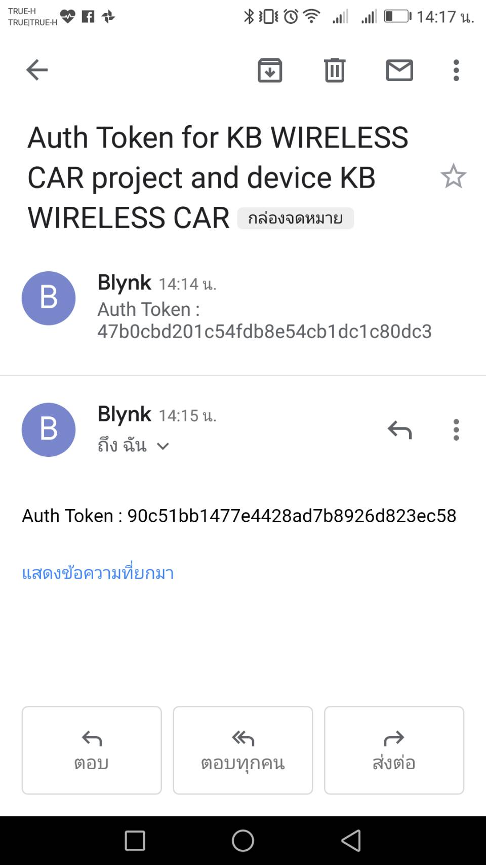

Slide 30
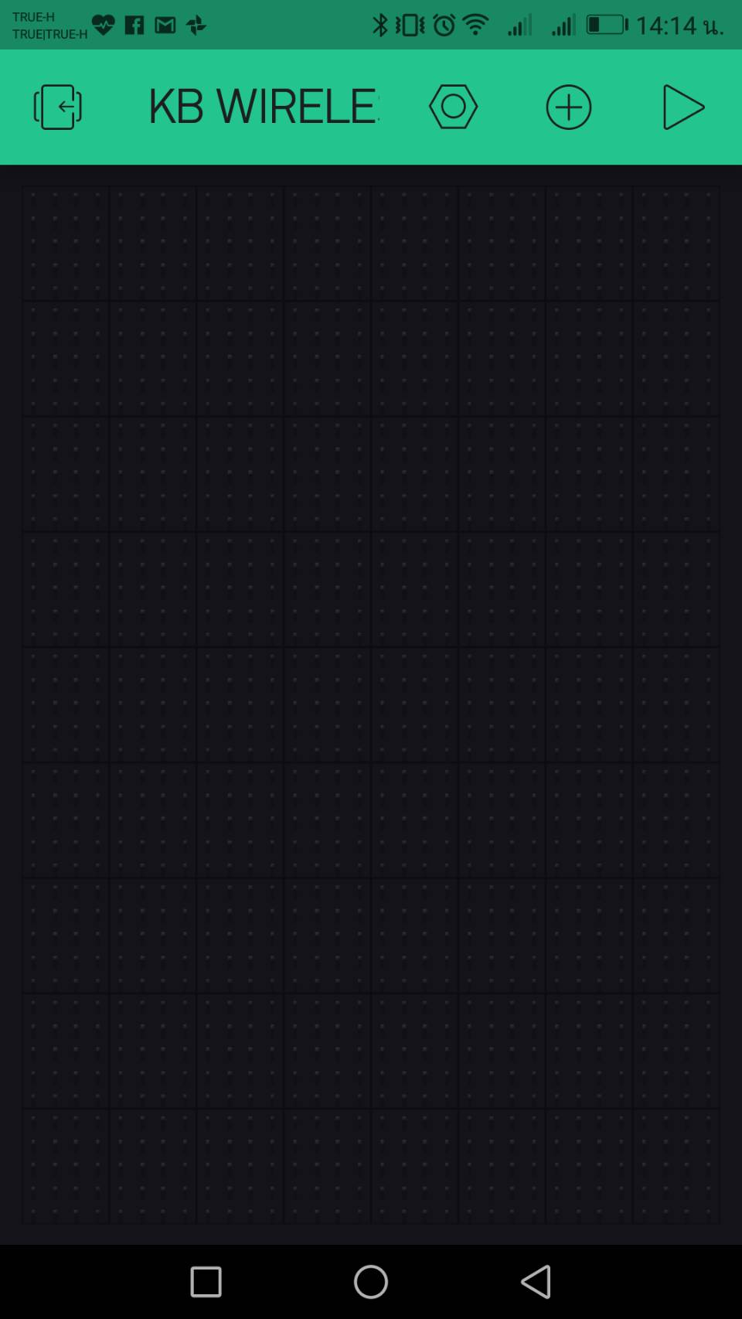

Slide 31
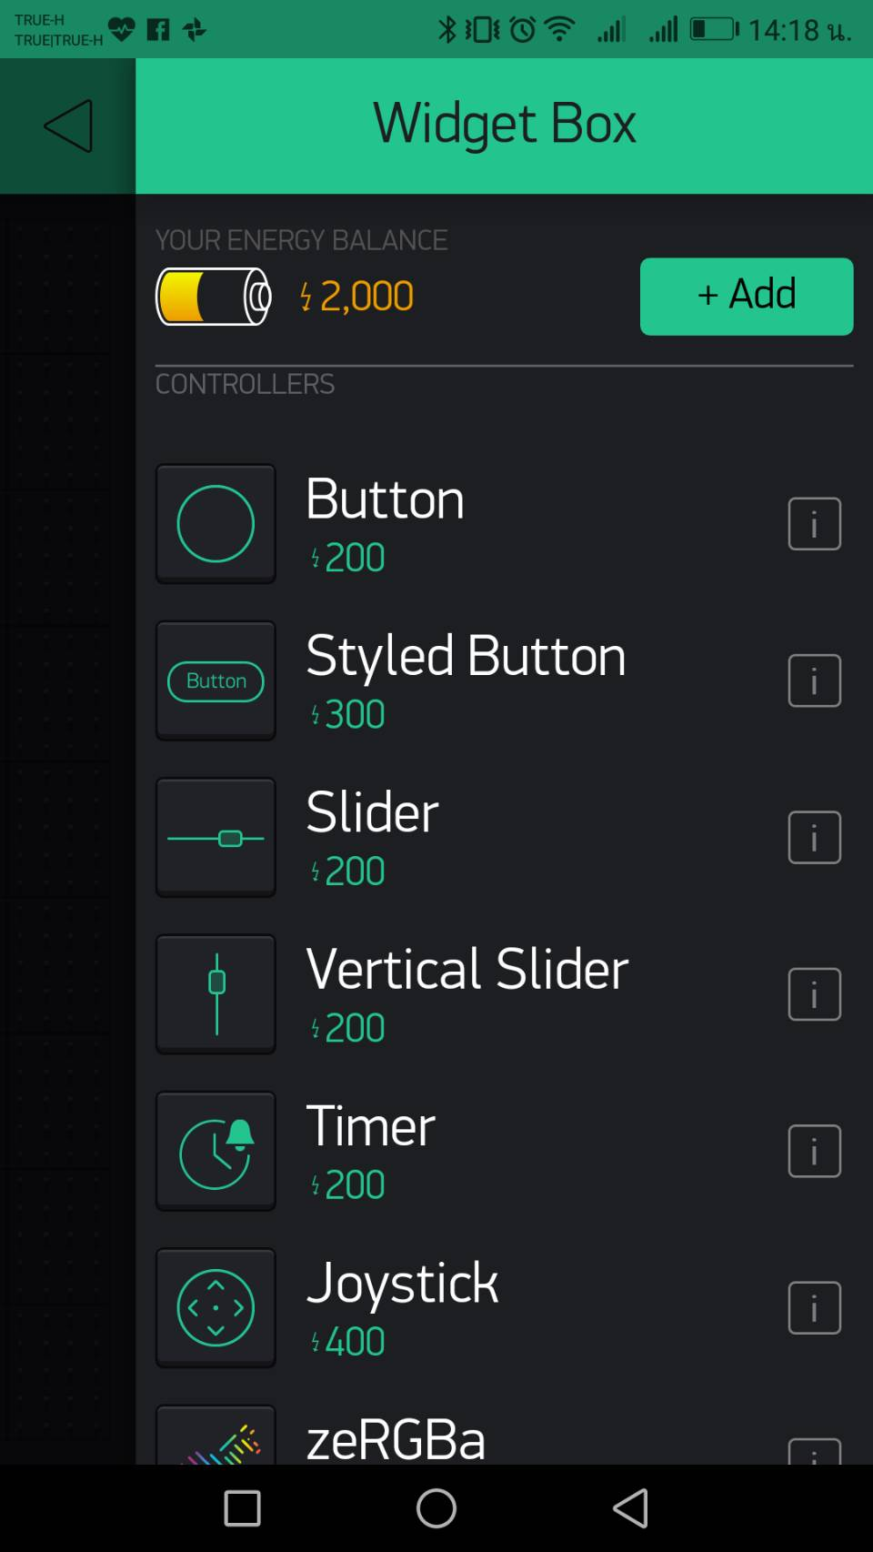
X 5

Slide 32
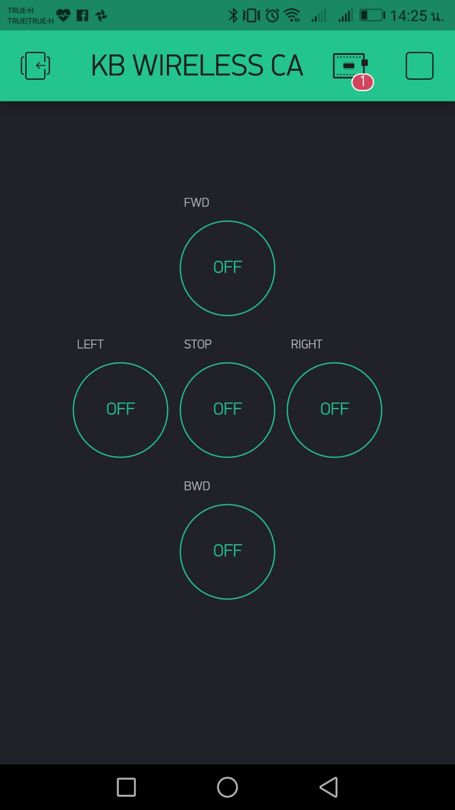

Slide 33
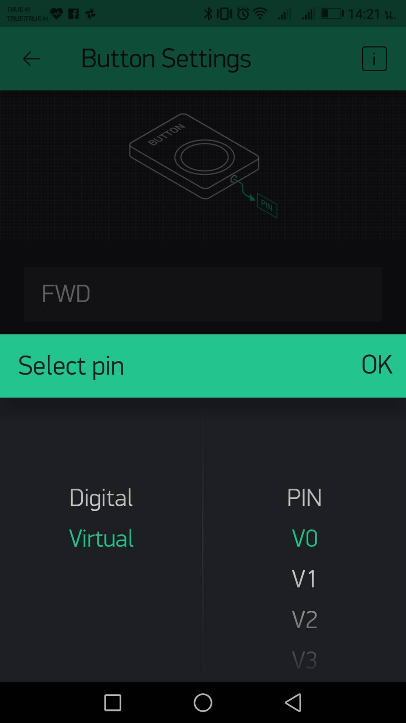

Slide 34
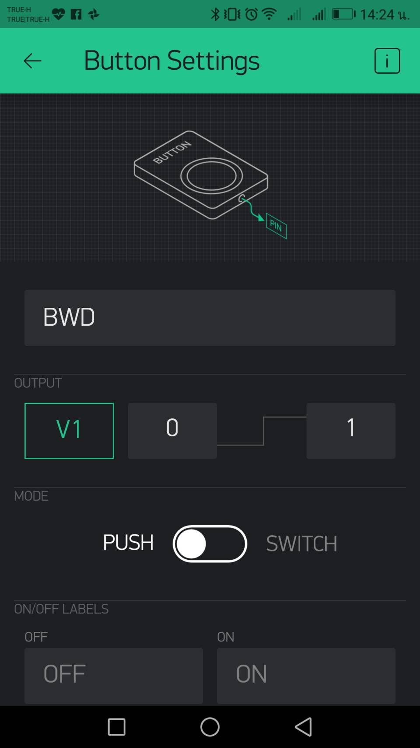

Slide 35
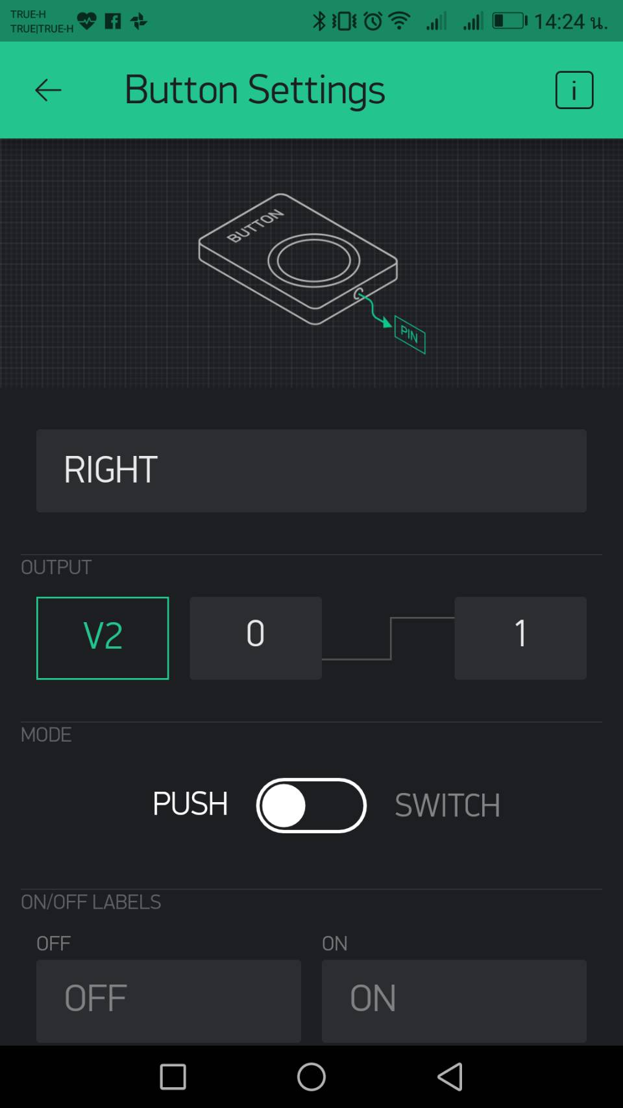

Slide 36
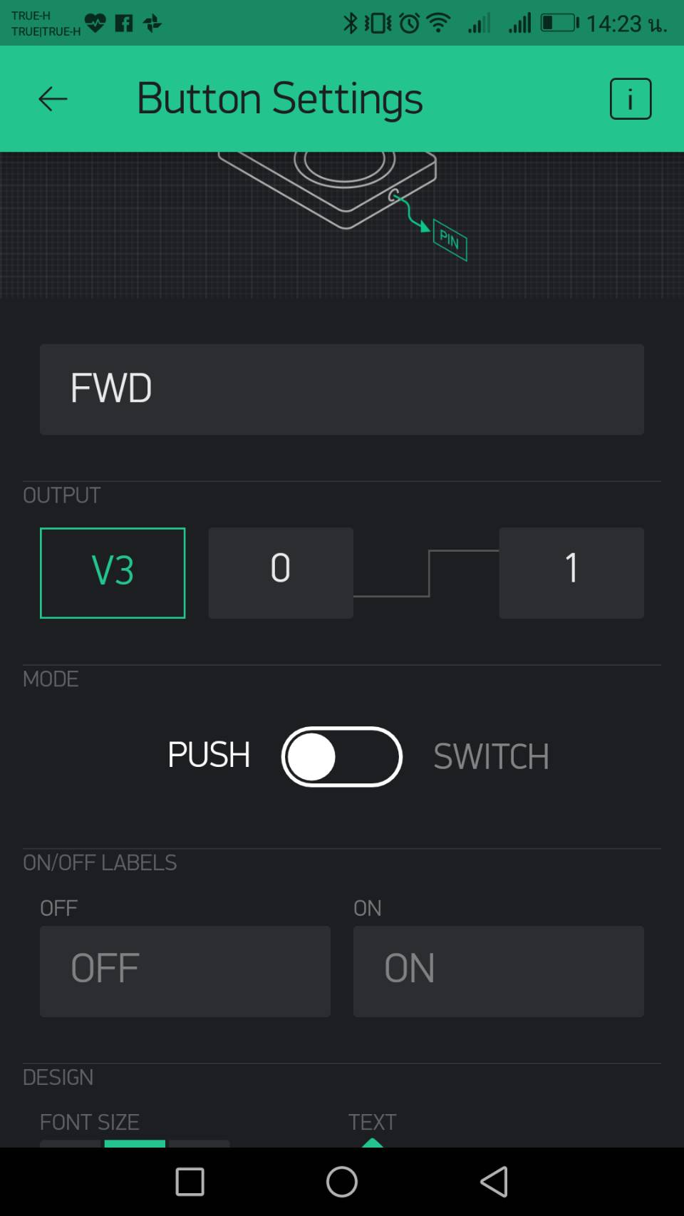

Slide 37
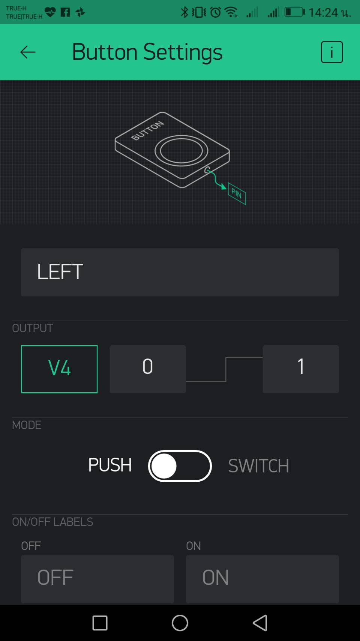

Slide 38
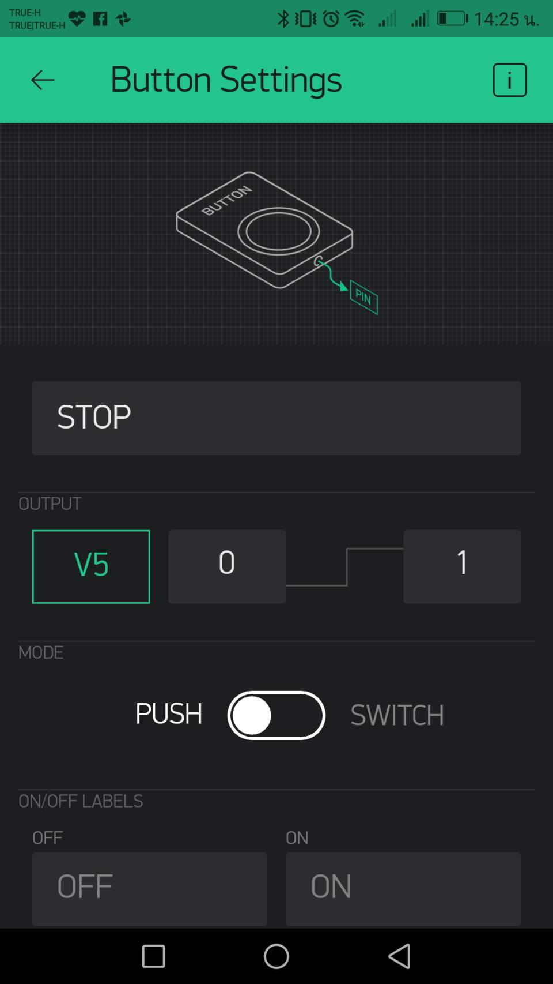

Slide 40
Go to staff to connect your model with Blynk!

Slide 41
Time to Drive!

Slide 42
Mini Challenge

Slide 43
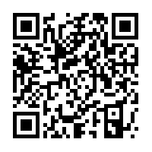

GitHub Example
GTT

